Slide 1
KIMCHI
PREMIUM
MFE 230GB · CURRENCY MARKETS · STRATEGY 2
Trading the crypto shadow exchange rate that Korea's capital controls create
Group 8
01 / 08
Notes:
Strategy two is about Kimchi premium. Because of capital control, crypto price traded in Korea can be materially than the price traded in the rest of the world. We want to test whether the premium predicts how the coin move, and how much of that edge survives funding and trading costs.

Slide 2
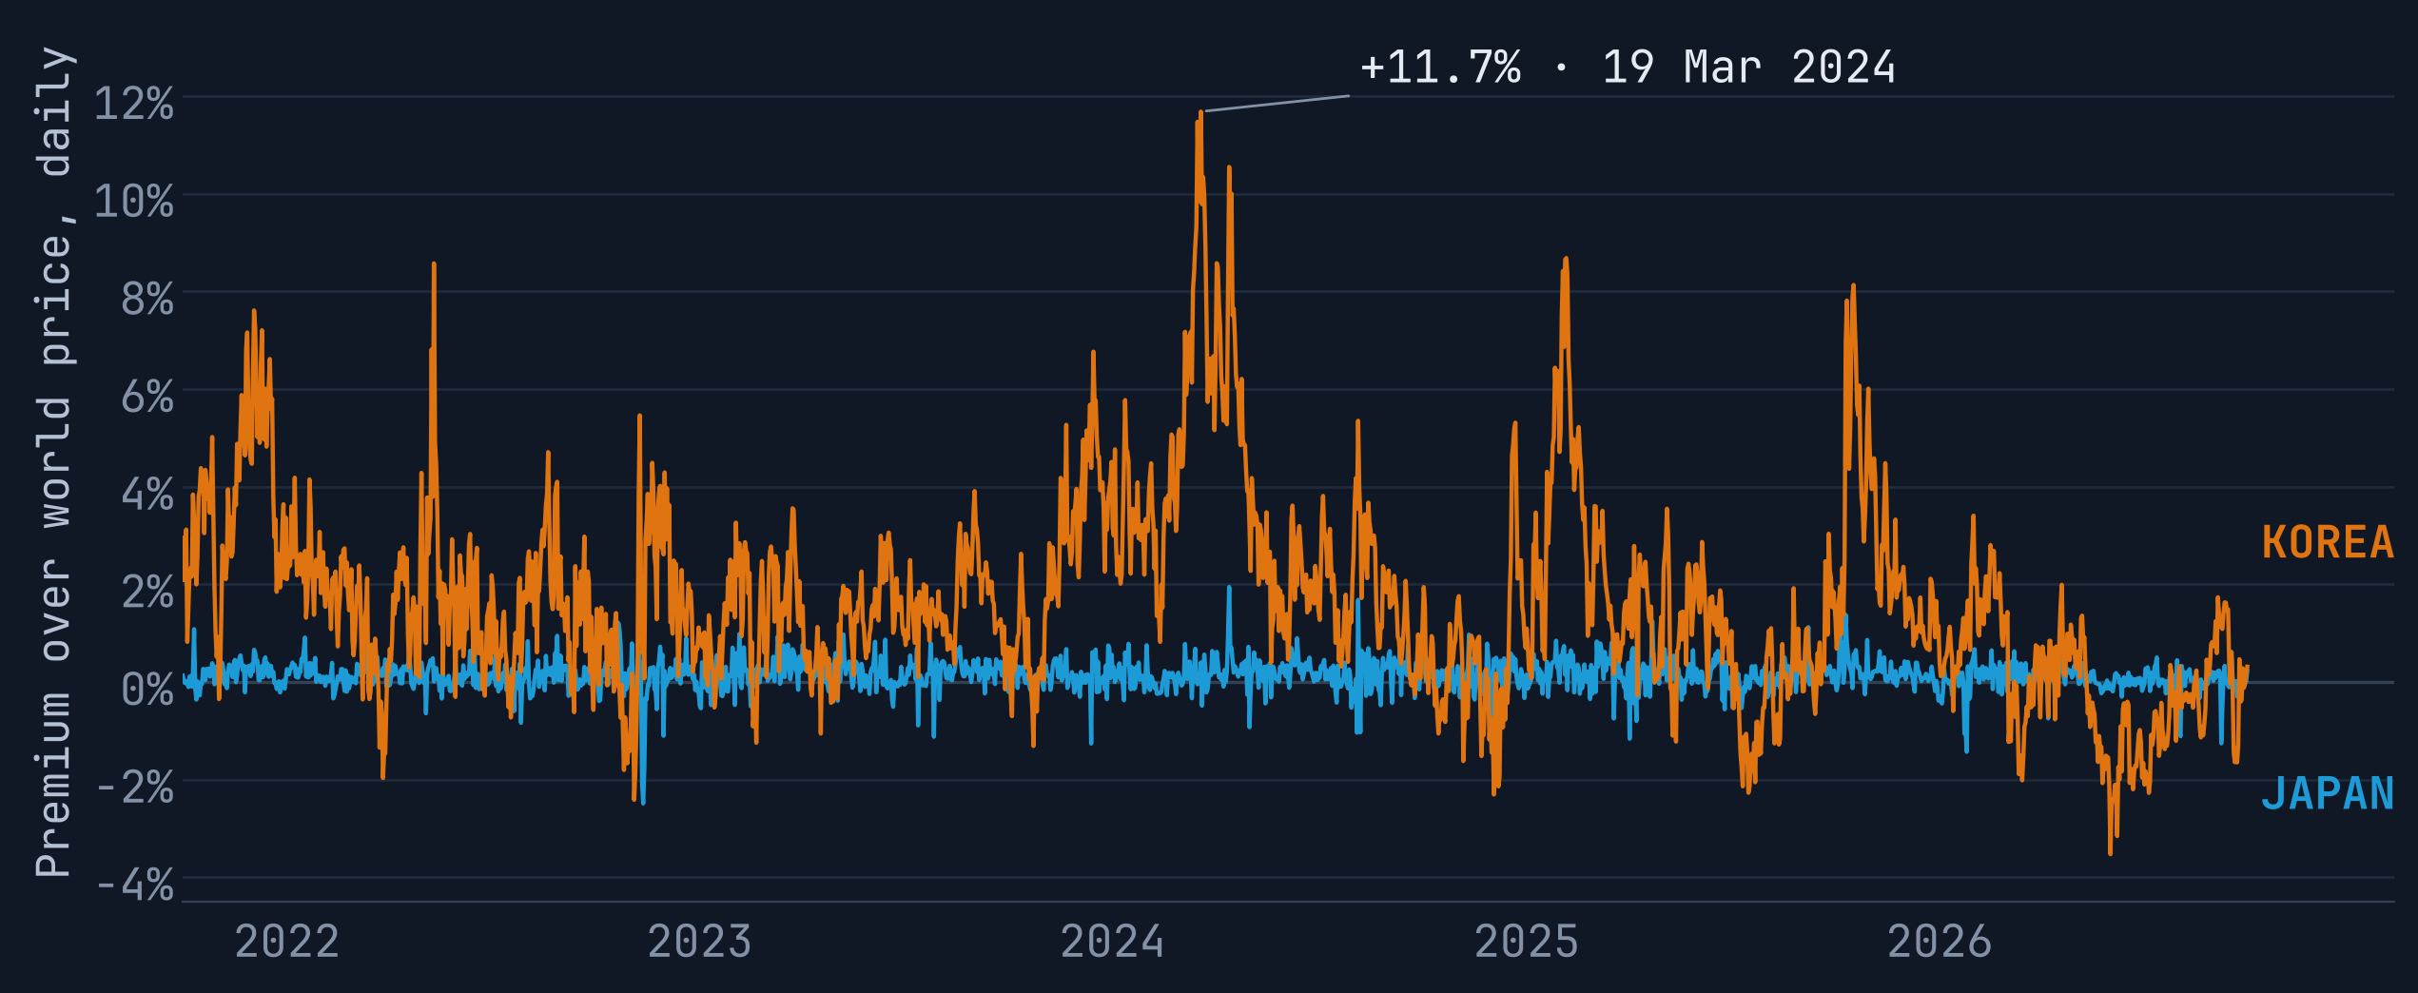
One coin, two prices
H1 · SEGMENTATION
BTC PREMIUM OVER BINANCE · DAILY
OCT 2021 – SEP 2026
19 MAR 2024
PEAK
BTC on Upbit
₩92,572,000
BTC on Binance
$61,937.40
Implied ₩ per $
1,495
Market ₩ per $
1,338
Kimchi premium
+11.7%
Last 5 years | Korea | Japan
Average | 1.70% | 0.14%
Days above 2% | 37% | 0%
Half-life | 8.4 days | 0.6 days
Korea's premium averages 1.7%, Japan's 0.1%. Same coins and the same retail crowd, but won can't leave Korea and yen can leave Japan.
02 / 08
Notes:
Here is the historic bitcoin premium chart. In general, bitcoin is traded with a premium in Korea as there are a lot of risk loving retail investors. On the most extreme date, one bitcoin cost 92.6 million won on Upbit and 61,937 dollars on Binance. After adjusting for exchange rate, this is a 11.7 percent premium.
Korea premium averages 1.7 percent, sits above 2 percent on more than a third of days, and a jump takes about eight days to halve. We compare it with Japan and this premium does not appear in Japanese market. Japan averages just 0.1 percent, never once reached 2 percent, and its gaps close within a day.
Arbitrage between Japan bitcoin price and the rest of the world was very popular. This is actually the earliest strategy used by Alamadea research. But as the market developed, market makers come in and the competition drove the premium away.

Slide 3
Coins flow in. Won can't flow out.
THE MECHANISM
WORLD MARKET
Coins move freely, in minutes
KOREAN MARKET
Binance
Upbit
Priced in USDT, open to anyone
Priced in won; residents with a real-name bank account
Won can't leave freely
Aggregate premium
Coin premium
κ = P(KRW) ÷ [P(USD) × ₩/$] − 1
π(i) = premium(i) − median premium
Measured on bitcoin: Korea's demand for crypto as a whole, priced through the capital control.
The exchange rate cancels. What is left is Korean demand for one coin, beyond the market.
03 / 08
Notes:
So why doesn't arbitrage close an 11 percent gap in Korea? Coins move freely: anyone can send bitcoin to an Korean exchange in minutes. But the issue is that only residents with a real-name bank account can trade on Korean exchanges, and won can't freely leave Korea, so the arbitrage profit gets stuck in won and you can do nothing about it.
That makes the premium kind of like a shadow exchange rate, like onshore versus offshore yuan.
We split the premium into two part. Kappa is the aggregate premium, measured on bitcoin. Pi is a coin's premium minus the median coin premium, so the exchange rate cancels and what's left is Korean demand for that one coin. Our hypothesis is that demand comes in bursts, spills into world prices, then reverses. In short, the premium is because the lack of liquidity, not because of traders having early information.

Slide 4
Short the coins Seoul overpays for
STRATEGY 2 · THE RULE
Measure π
Example
21 Sep 2026 · 105 coins, 21 a leg
01
Upbit vs Binance price, minus the median coin's premium; 7-day mean
Coin | Side | π | Funding/yr | Next week
ZIL | LONG | −697 bp | −152% | +9.3%
PIEVERSE | LONG | −34 bp | +35% | −6.5%
MINA | LONG | −28 bp | −40% | +25.5%
BABY | LONG | −25 bp | +9% | +21.4%
SAND | SHORT | +82 bp | −3% | −12.6%
INJ | SHORT | +104 bp | +5% | −0.1%
VTHO | SHORT | +133 bp | −267% | −15.5%
EGLD | SHORT | +994 bp | −7% | −24.9%
Filter
02
69 coins a week with a Binance perp and enough volume; drop |π| above 10%
03
Rank
Short the top fifth by π, long the bottom fifth, $1 a side
Hold
04
We will conduct a rebalance on Monday 00:00 UTC on Binance. Execution cost is set to 10bps.
Four extreme coins per leg. Next week = the position's P&L with funding. Both legs rallied about 14%; the book made +0.42% before costs, +0.12% after.
04 / 08
Notes:
The rule of our strategy is quite simple. Every Monday, we measure each coin's pi, averaged over the past week. The universe is coins on Upbit that also have a Binance perpetual and enough volume. We drop any premium above 10 percent as that usually means deposits are suspended or a delisting is coming soon. Next, we short the fifth of coins Seoul overpays for most, buy the fifth it sells, hold Binance perpetuals for a week including funding, and charge 10 basis points per unit traded. 10 bps are actually a conservative estimate as you can get lower fee on Binance by buying their token.
For example, here's the latest week. ZIL traded 7 percent below the typical coin in Seoul, so we were long, and it gained 9 percent. EGLD sat just under the 10 percent cutoff, so we were short, and it rose 25 percent against us. Both legs rallied about 14 percent, so the book made 0.4 percent before costs.
Keep an eye on the funding column: several shorts carry deeply negative funding. We will come back to that.
Next I will pass it to Sreenivaas to talk about the backtesting results.

Slide 5
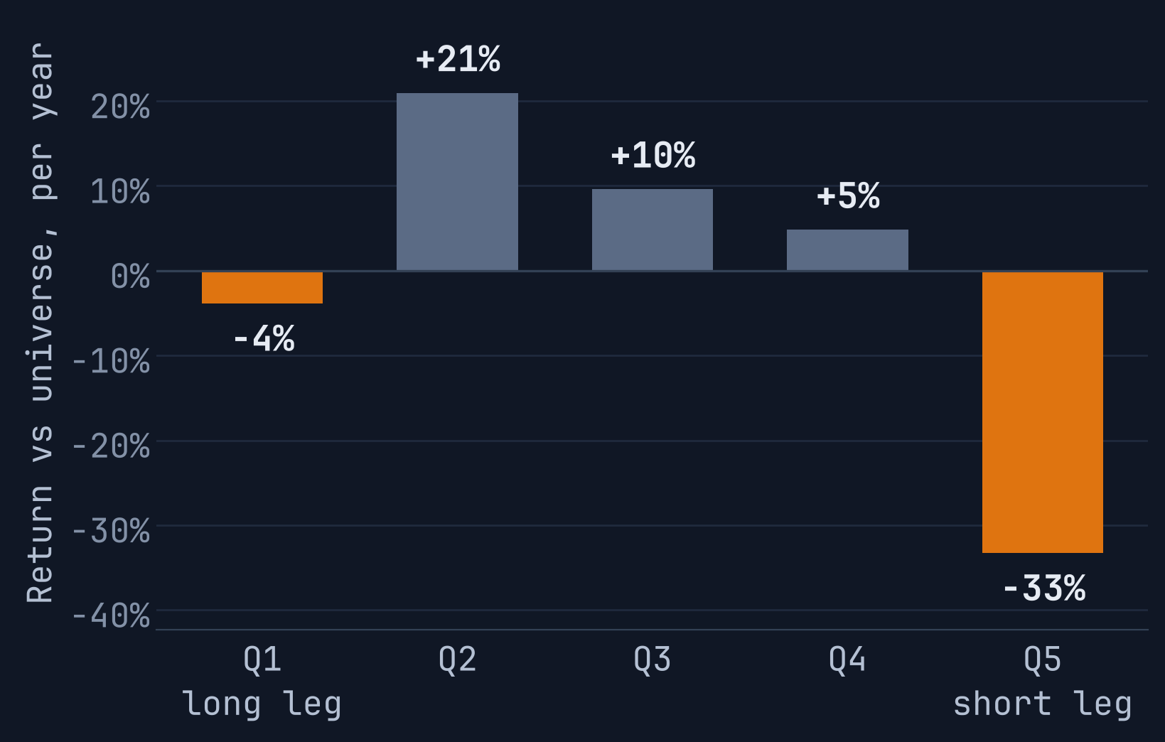
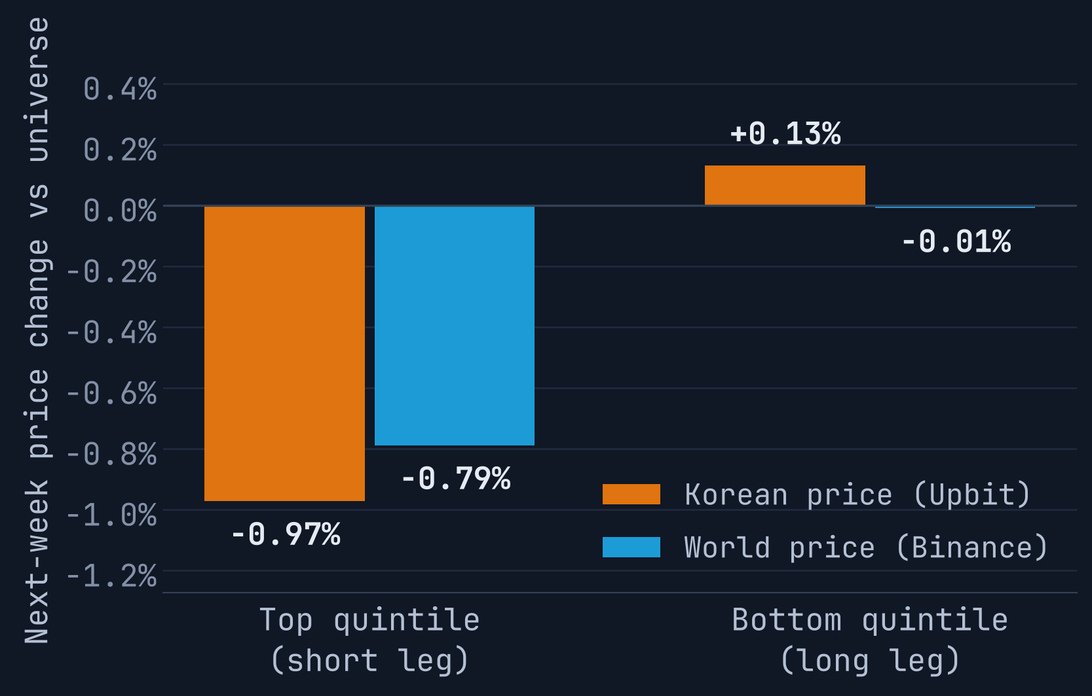
Hot coins fall back the next week
H2 + H4 · SIGNAL TESTS
RETURN VS UNIVERSE
WHICH PRICE MOVES
−1.9%
next-week return per point of premium (t = −2.7)
18 of 30 bp
of the top fifth's premium closes in a week (t = −4.7)
3 weeks
Returns fall from Q2 to Q5, and the top fifth falls in Seoul and on Binance. The bottom fifth does not bounce: the money is in the short leg.
builds to −4.2% per point by week three (t = −3.2)
05 / 08
Notes:
About a minute. Before trading it: does the signal carry information? Three tests, all on the last five years. First, Fama–MacBeth: each week, regress every coin's next-week Binance return on its local premium. One point of premium means 1.9 percent lower return the next week, t of minus 2.7, and it survives controls for past returns, volume and funding. The effect keeps building for three weeks, to 4.2 percent. Second, the channel. The top fifth of coins carries a 30 basis point premium, and 18 of those basis points close within a week. Mostly through the Korean price, which falls about 1 percent relative to other coins, but the world price falls too, 0.8 percent: price pressure that spilled into world prices and reverses, as hypothesised. Third, the left chart: the top fifth trails the universe by 33 percent a year. But the bottom fifth, the coins Koreans dump, does not bounce; it trails slightly too. The money is in the short leg.

Slide 6
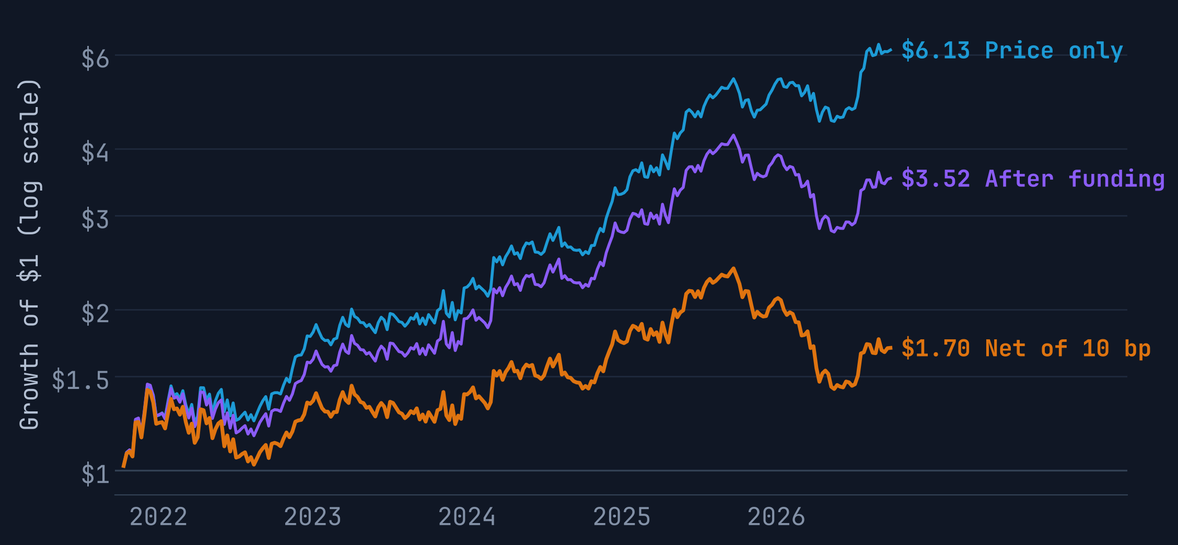
+14.8% a year after funding and costs
RESULTS · OCT 2021 – SEP 2026
Per year | Oct 21–Sep 26
Price P&L | +40.5%
Funding | −11.1%
Costs, 10 bp | −14.7%
Net return | +14.8%
Volatility | 29.2%
Sharpe, gross / net | 1.01 / 0.51
t-stat, net | 1.31
Max drawdown | −40.5%
Turnover | 2.8× a week
Break-even cost | 20 bp
GROWTH OF $1 · LOG SCALE
260 WEEKS
$1 long and $1 short in Binance perpetuals. This window was chosen after the pre-registered 2020–26 test; that run is in backup B4.
06 / 08
Notes:
About a minute and a half. Does it make money? Over the last five years, yes, but watch where the money goes. On prices alone the book earns 40 percent a year: the blue line, six times your money. Funding takes 11 percent a year, because our shorts sit in coins with negative funding; I will explain why on the next slide. Trading costs take another 15 percent, because the book turns over almost three times a week. Net, it earns 14.8 percent a year with 29 percent volatility: a Sharpe ratio of 0.51, or 1.0 before costs, and a dollar becomes 1.70. Two cautions. The t-statistic is 1.3, so five years are not enough to call it significant. And it is very sensitive to costs: at 20 basis points per unit traded the Sharpe ratio is zero. One disclosure: we chose this five-year window after seeing the pre-registered 2020 to 2026 test; that run is in the backup.

Slide 7
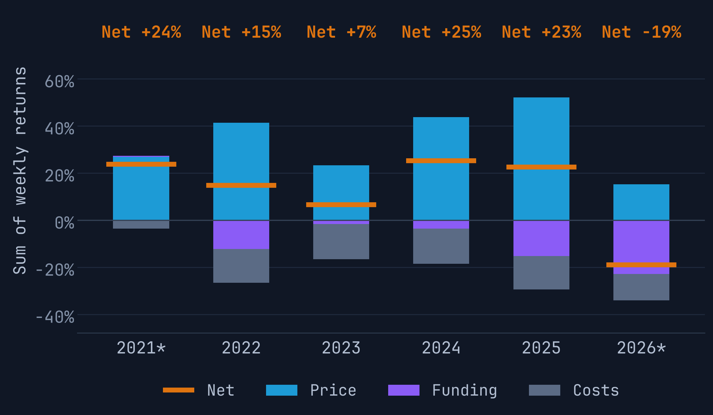
Squeezes and funding: where it loses
STRATEGY 2 · RISK
P&L BY YEAR · SUM OF WEEKS
* PART YEAR
Squeezes
Week of 30 May 2022: short WAVES at a ninth of the leg. It rose 82% in a week and the book lost 10.3%, its worst week.
Crowded funding
Arbitrageurs shipping coins to Seoul short the perp as a hedge. Our short leg pays 12% a year in funding beside them; in 2026 funding cost the book 23%.
Market risk
No bitcoin beta (0.03 up, −0.01 down); it made money in the LUNA and FTX weeks. Worst drawdown −40.5%, Sep 2025 to May 2026.
07 / 08
Notes:
About a minute. When does it lose? The chart splits each year's P&L: blue is price, purple is funding, grey is costs, and the orange bar is the net. Price pays every year. Two things hurt. First, squeezes. In the week of 30 May 2022 we were short WAVES at a ninth of the short leg; it rose 82 percent in a week and the book lost 10 percent. Second, funding. A Korean arbitrageur who ships coins to Seoul hedges by shorting the Binance perpetual, so the coins with the highest Korean premium carry negative funding. Our short leg pays 12 percent a year for sitting next to that hedge, and in 2026 funding cost the book 23 percent, which is why 2026 is down 19 percent so far. On market risk: no bitcoin beta, and it made money in the LUNA and FTX crashes. The worst drawdown was 40 percent, from September 2025 to May 2026.

Slide 8
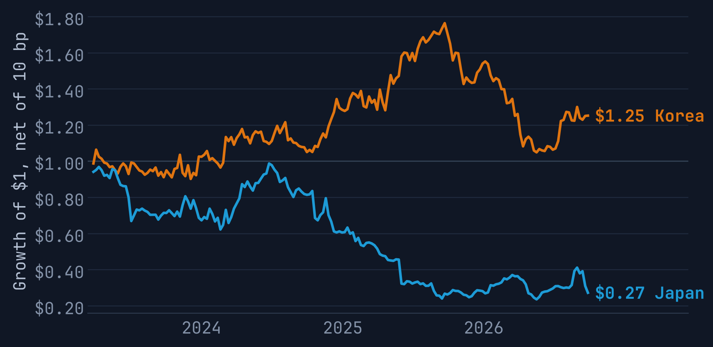
No capital controls, no edge
ROBUSTNESS · JAPAN PLACEBO
SAME RULE, SAME 184 WEEKS
NET OF 10 BP
KOREA · UPBIT
JAPAN · BITBANK
0.37
−0.63
Sharpe, +9.8% a year
Sharpe, −27% a year
Test | Five-year verdict
H1 Segmentation | Yes · Korea 1.7%, Japan 0.1%
H2 Reversal | Yes in regressions; trade t = 1.3
H3 Froth | Not in this window · t = −1.2
H4 Channel | Yes · Seoul −0.97%, world −0.79%
Placebo | Japan loses 27% a year
Trapped capital makes the signal; funding and costs eat nearly two-thirds of it.
08 / 08
Notes:
About a minute. One robustness test, the one that speaks to the mechanism: a placebo. We run the identical rule on bitbank's yen market in Japan, where capital moves freely. Japan has enough coins only from March 2023, so we compare the same 184 weeks. Korea earns a Sharpe ratio of 0.37 in those weeks; Japan loses 27 percent a year, a Sharpe of minus 0.63. If the signal were just crypto noise or a generic retail effect, Japan should work too. It doesn't: the edge exists only where capital is trapped. So the verdict. Segmentation, yes. Reversal, yes in the regressions and as a trade, though not yet statistically significant. Froth, not in this window. Channel, yes: the gap closes in Seoul, and world prices follow. And the price of the trade: the arbitrageurs' hedge sets the funding, and with trading costs that eats nearly two-thirds of the price gain. Same lesson as Strategy 1: crowding sets the price of a trade. Thank you.

Slide 9
The kimchi-premium long-short
BACKUP · TERM SHEET
UNIVERSE
Upbit won-market coins with a Binance USDT-margined perpetual; 7-day average volume of at least ₩500 million on Upbit and $5 million on the perp; stablecoins, wrapped tokens and ticker collisions excluded
SIGNAL
π(i) = ln P(KRW) − ln P(USDT) − ln(₩/$), minus that day's median coin; mean of the last 7 daily closes at 00:00 UTC
FILTERS
Drop |π| above 10% (suspended deposits, delistings); trade only with 20 or more eligible coins
POSITION
Short the top fifth by π, long the bottom fifth; equal weights; $1 a side; Binance perpetuals
TIMING
Rebalance Monday 00:00 UTC and hold 7 days; perp price change plus funding (longs pay when it is positive)
COSTS
10 bp per unit traded, turnover measured from drifted holdings; the net Sharpe ratio reaches zero at about 20 bp
SAMPLE
Reported: formation weeks 4 Oct 2021 – 21 Sep 2026 (260 weeks, 69 eligible coins a week, 216 coins traded). The pre-registered 2020–26 run ships in the package.
B1 / B4
Notes:
Backup for questions: the full term sheet. The universe is every coin on Upbit's won market that also has a Binance USDT-margined perpetual and enough volume on both venues. Stablecoins, wrapped tokens and ticker collisions are excluded; for example, Upbit's TON was a different token from Binance's TON. The signal is the coin's log premium net of the median coin's, so the exchange rate cancels, averaged over seven daily closes. Coins with a premium above 10 percent are dropped. The book is short the top fifth and long the bottom fifth in Binance perpetuals, rebalanced Monday at midnight UTC, with funding included and 10 basis points per unit traded; the net Sharpe ratio reaches zero at about 20 basis points. The reported sample is the 260 weeks from October 2021 to September 2026.

Slide 10
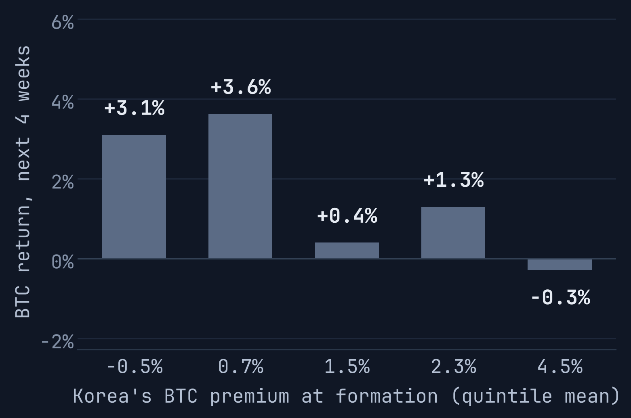
Froth barely predicts bitcoin
BACKUP · H3 FROTH
BTC 4-week return on κ | Estimate
Slope per point of κ | −0.84%
t-stat (Newey–West) | −1.2
R² | 1.1%
Brake weeks | 22 of 260
BTC Sharpe, always long | 0.33
BTC Sharpe, with brake | 0.22
BTC NEXT 4 WEEKS BY Κ QUINTILE
The pre-set brake sits out a week when κ is above its trailing-year 90th percentile. Bitcoin happened to rally in those 22 weeks, so the brake cost money. 257 weekly observations; Newey–West with 8 lags for the overlapping returns.
B2 / B4
Notes:
Backup on hypothesis three: does Korean froth predict bitcoin? In the last five years a one-point higher premium is followed by 0.84 percent lower bitcoin returns over the next four weeks, but the t-statistic is only minus 1.2 and the R-squared is 1 percent. The chart shows the shape: bitcoin's next four weeks are best when Korea trades at a discount or a small premium and slightly negative in the top quintile, but the differences are noisy. The brake we wrote down in advance, sitting out weeks when the premium is in the top decile of its past year, fired in 22 weeks and lowered bitcoin's Sharpe ratio from 0.33 to 0.22, because bitcoin happened to rally in those weeks. So H3 is not supported in this window.

Slide 11
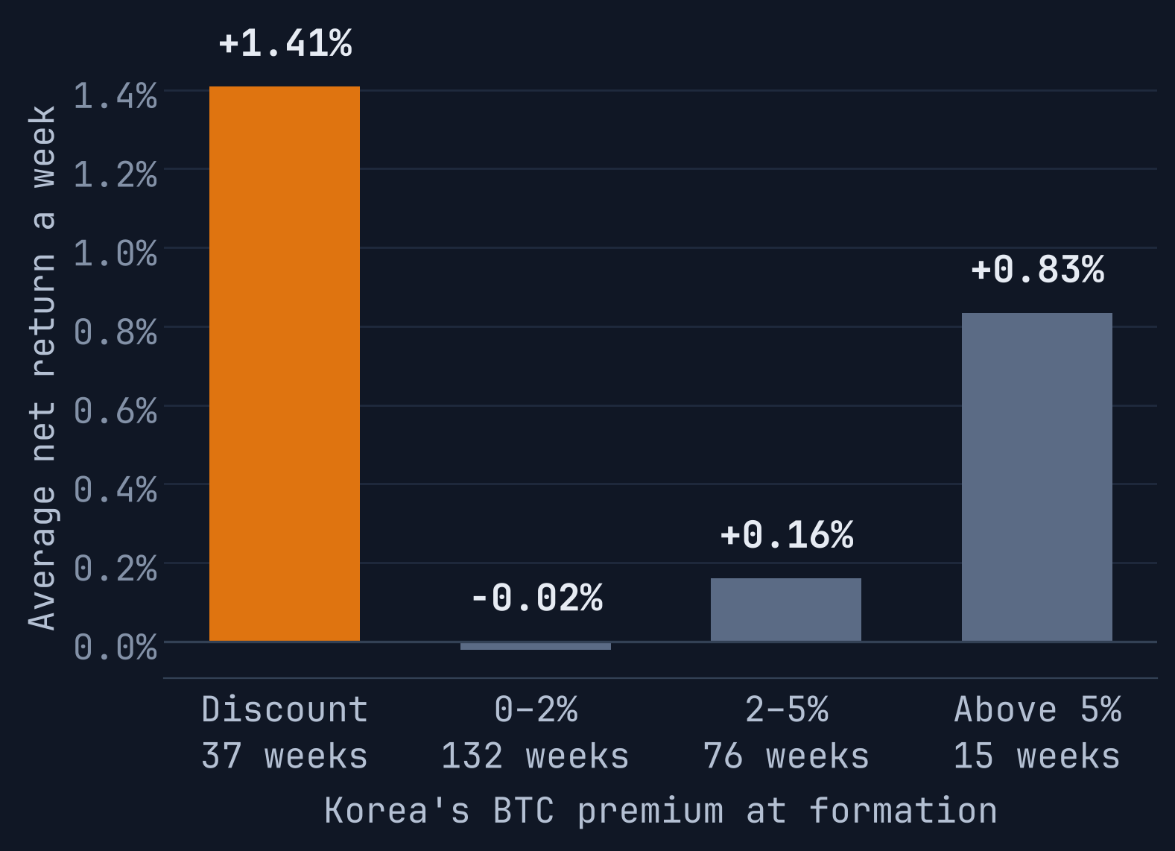
Regimes, stress weeks and exposures
BACKUP · RISK DETAIL
Week of | Book | Longs | Shorts | BTC
LUNA, May 2022 | +3.9% | −21.1% | +25.3% | −8.0%
FTX, Nov 2022 | +2.5% | −25.7% | +28.5% | −21.6%
Yen unwind, Aug 2024 | −8.2% | −1.6% | −6.4% | +0.9%
Martial law, Dec 2024 | +3.1% | +11.9% | −8.5% | +3.6%
10 Oct 2025 crash | −5.6% | −22.7% | +17.4% | −7.0%
NET RETURN BY KOREA'S PREMIUM
Longs and shorts are each leg's P&L that week. Weekly exposures: BTC up 0.03, BTC down −0.01, altcoins minus BTC −0.09 (t = −1.9), momentum +0.13 (t = 2.2); changes in VIX, the won and κ insignificant.
B3 / B4
Notes:
Backup on risk. On the left, the book's average weekly return by Korea's aggregate premium at formation: plus 1.4 percent a week when Korea trades at a discount, about zero in normal times, and plus 0.8 percent in the 15 weeks when the premium is above 5 percent. On the right, the stress episodes. The book is roughly neutral in market crashes like LUNA, FTX and the October 2025 liquidations, because both legs fall together; on the Korean martial-law night it made 3 percent. It lost 8 percent in the August 2024 yen carry unwind, when both legs went against it. Factor exposures: no significant bitcoin beta, a mild negative loading on altcoins over bitcoin, so it lags a little in alt seasons, and a positive loading on momentum.

